Slide 1

Comparative Study on The Perfect Moment for Jakarta and Indonesia to Switch Back into Normal Life Using Simple MA, ARIMA, VAR, and RNN-LSTM Models
The Four Horsemen Team
Universitas Indonesia

Slide 2


Latar Belakang Kelompok
Universitas Indonesia
Kami semua berasal dari Universitas Indonesia dan sedang menjalani semester 7 (Angkatan 2018)
Universitas Indonesia adalah kampus modern, komprehensif, terbuka, multi budaya, dan humanis yang mencakup disiplin ilmu yang luas.
Kampus utama Universitas Indonesia terdapat di Margonda, Depok, Jawa Barat.

Slide 3




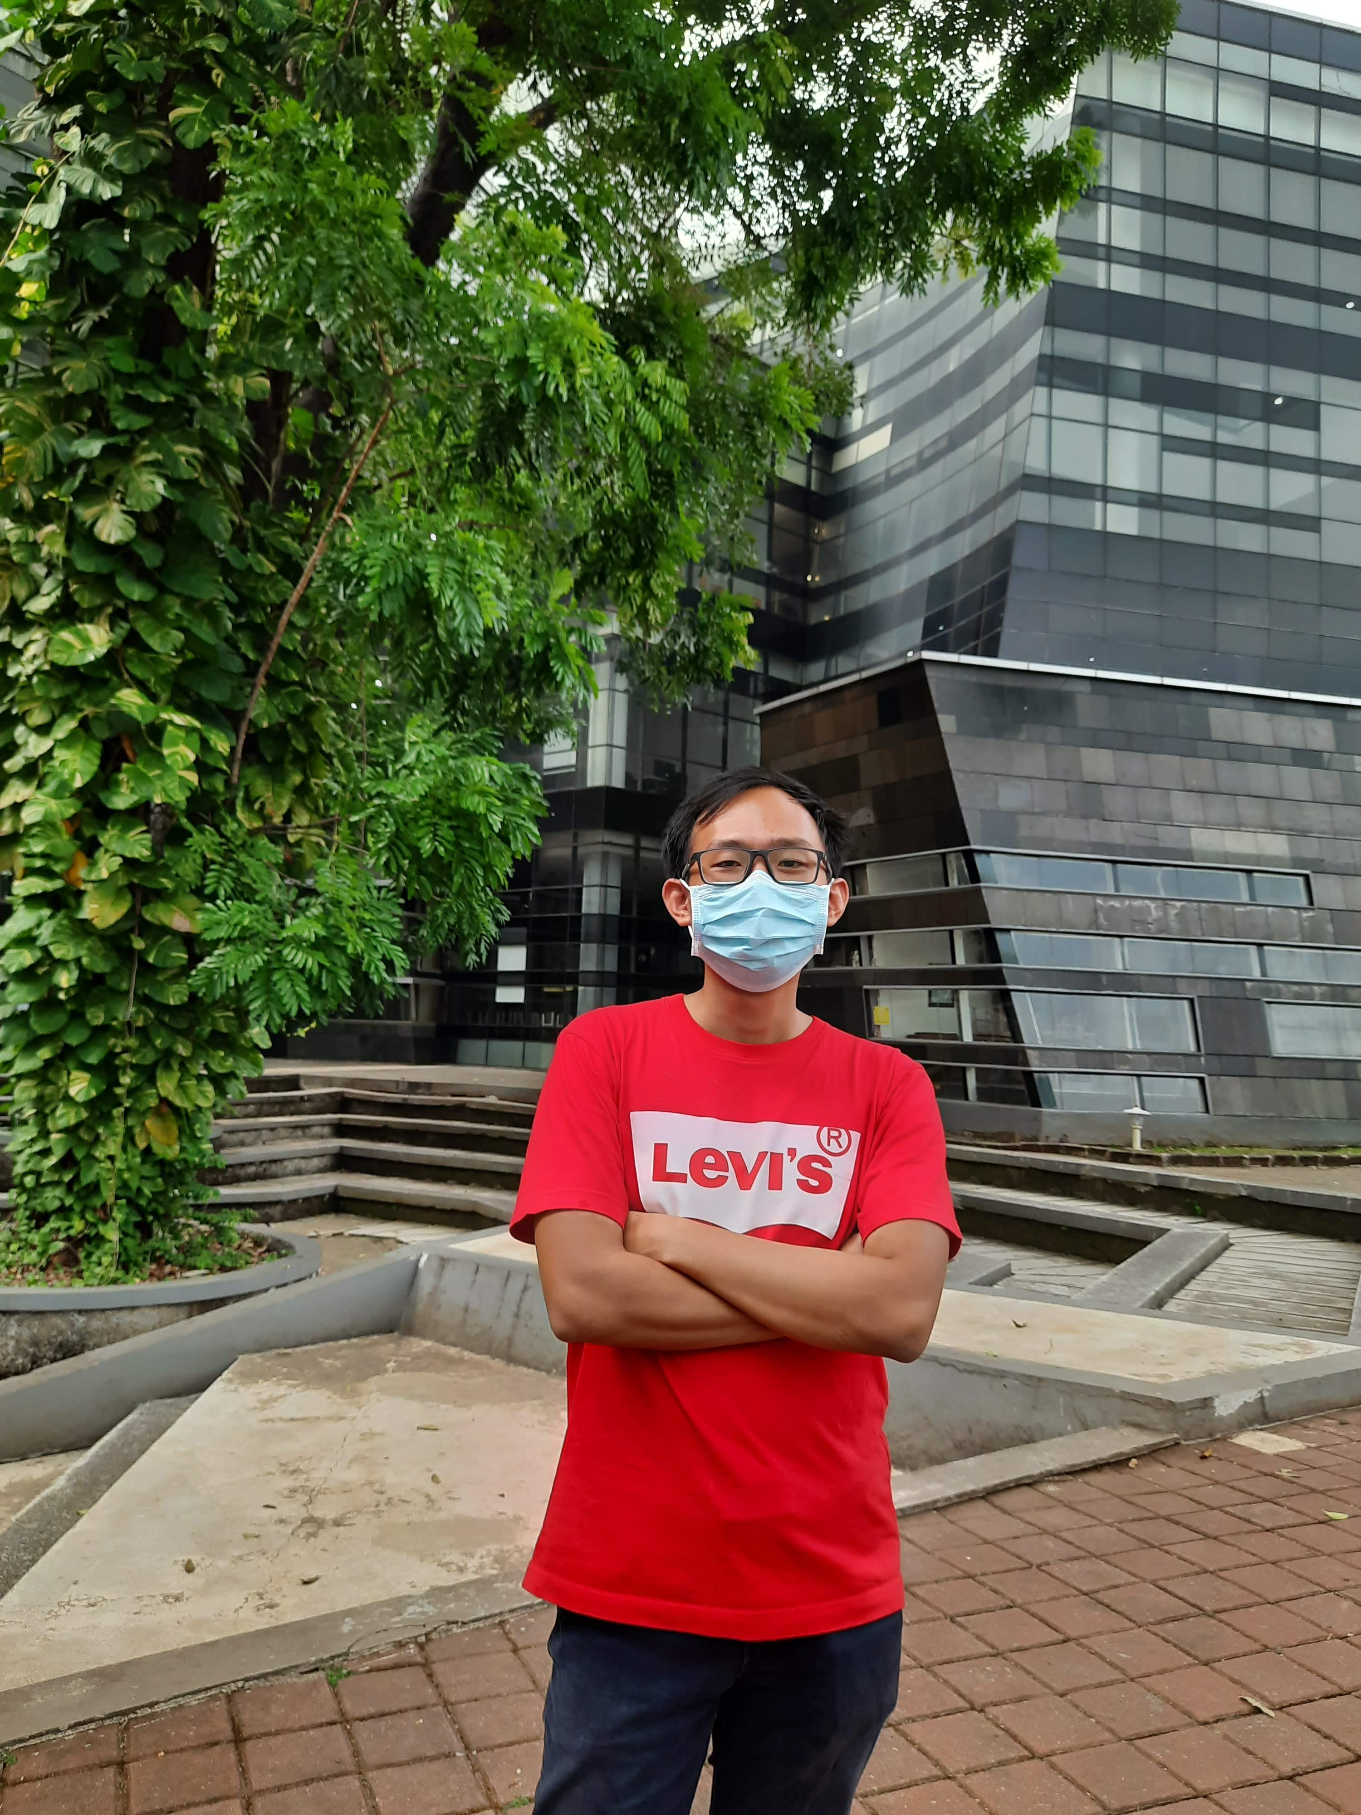
This is Us
Nathanael Theovanny Averro
Arya Cakra
Muhammad Naufal Harits
Richard Famson
20 Agustus 2000
richard.Famson@ui.ac.id
081316697797
Bekasi
www.linkedin.com/in/richard-famson-62b711184
15 September 1998
arya.cakrabuana@ui.ac.id
Depok
https://www.linkedin.com/in/arya-cakrabuana-kusdiana-86270b18a
14 Februari 2000
muhammad.naufal88@ui.ac.id
085771882750
Depok
https://www.linkedin.com/in/muhammad-naufal-harits-48602b213/
13 Juni 2000
nathanael.theovanny@ui.ac.id
Bekasi
https://www.linkedin.com/in/nathanaeltheo/

Slide 4
Team Leader Resume Muhammad Naufal Harits
Education
Management Finance, Universitas Indonesia (Present)
International Exchange Program, Keio University (2021)
Machine Learning Student, Google Bangkit Academy (2021)
Mathematics for Machine Learning, Imperial College London (2021)
Related Experiences
Machine Learning Project Lead, Google Bangkit Academy (2021)
Business Intelligence Team Lead, Management Student Society (2020)
Certifications
DeepLearning.AI TensorFlow Developer Certification
TensorFlow: Data and Deployment Specialization
Pluralsight Machine Learning Literacy
Google IT Automation with Python Specialization
Awards and Achievements
Most Potential FEB UI Student
Jabar Future Leaders Scholarship Awardee

Slide 5
Team Member Resume Nathanael Theovanny Averro
Education
Actuarial Science, Universitas Indonesia (Present)
Related Experiences
Laboratory Teaching Assistant at Department of Mathematics FMIPA UI (2019 – Now)
Awards and Achievements
READI Project Scholarship Awardee (2018 – 2019)
Top 15% Calculus Competition HIMATIKA ITS 2020
Certifications
Machine Learning Fundamentals with Python Track, Datacamp (2020)
A10 - Financial Mathematics (PAI)
A20 - Probability and Statistics (PAI)
A30 – Economy (PAI)
A40 – Accounting (PAI)
A50 - Statistical Methods (PAI)
A70 - Risk Models and Theories (PAI)

Slide 6
Team Member Resume Richard Famson
Education
Statistics, Universitas Indonesia (Present)
Related Experiences
Laboratory Assistant at Department of Mathematics FMIPA UI (2019-2021)
Certifications
Python Fundamentals for Data Science by DQLab (2021)
Introduction to Python by Data Camp 2019

Slide 7
Team Member Resume Arya Cakra
Education
1. Economics, Universitas Indonesia (Present)
Related Experiences
1. Digital Marketing Internship, Griity
2. General Banking Program, Bank Mandiri

Slide 8
Topic Background
COVID-19 Pandemic has taken a toll not only on health issues but also the economy. Various countries have different approach to this problem and resulted in unique outputs.
As for Indonesia, a strict social distancing measures known as PPKM has been implemented to prevent the spread of COVID-19. This preventive measures are arguably effective to control new cases but at the same time destroying small and medium enterprises that are very dependent on consumer mobility and daily traffic.

Slide 9
Topic Background
Using available data at hand, statistician could create some predictions to at least estimate when the PPKM will be removed and therefore giving impacted businesses a clear expectations on how long they should plan their daily operation costs to survive until PPKM is removed and the economy could go back to normal.
Using this estimation, we can also give advice to business owners or managers to pivot their offline marketing and offline sales to online marketing and online sales.

Slide 10
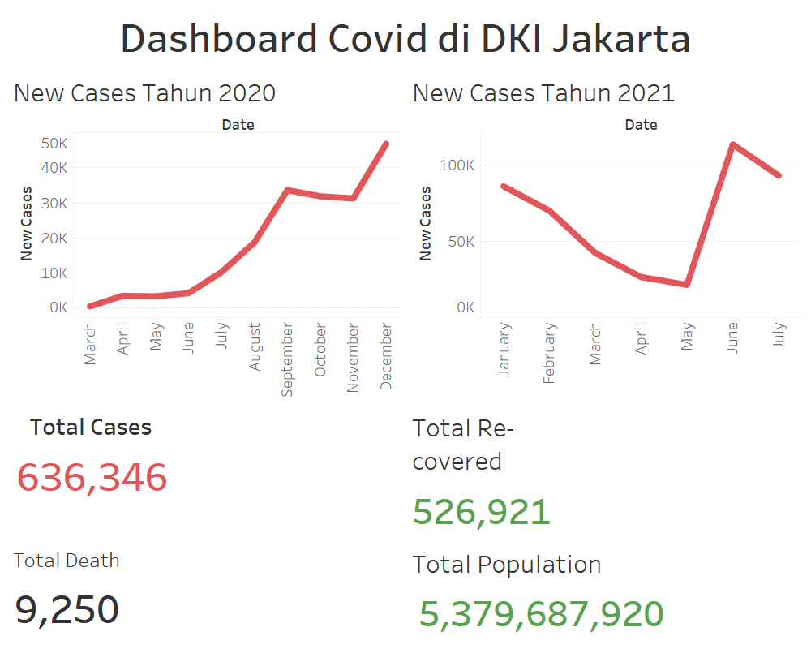

Dashboard Data yang dipakai

Slide 11
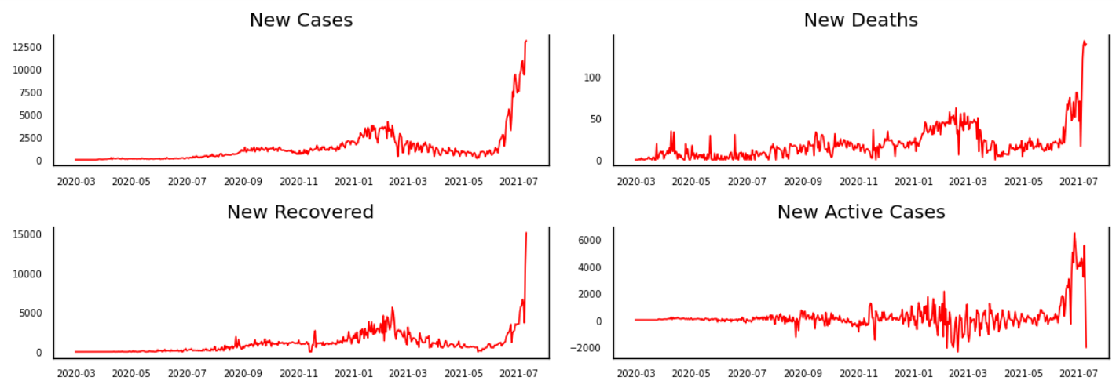
Preview Dataset

Slide 12
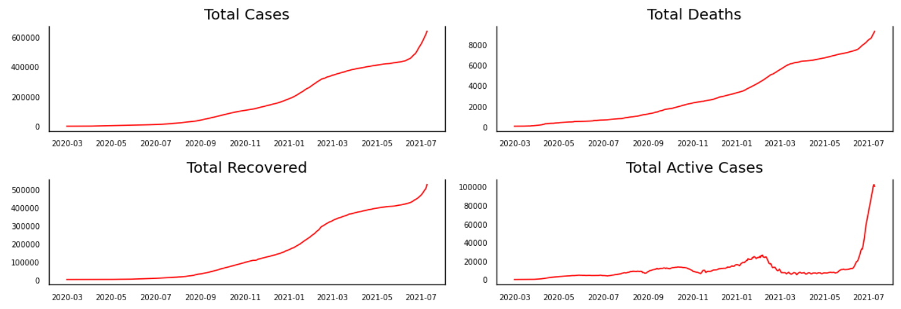
Preview Dataset

Slide 13
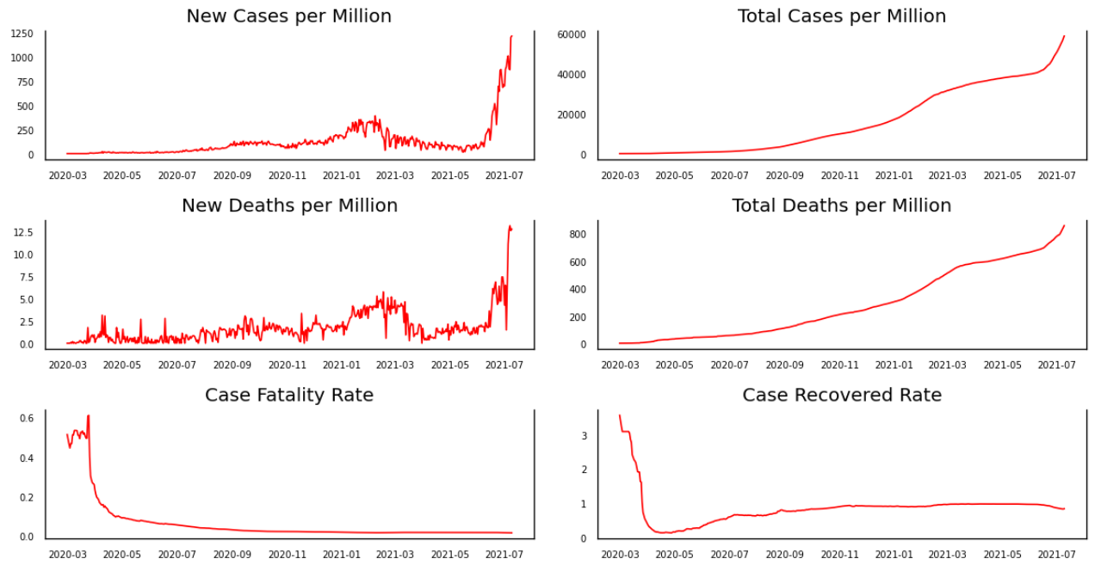
Preview Dataset

Slide 14

What Did We Predict?
1
2
3
People Fully Vaccinated
Daily New Cases
Daily New Deaths

Slide 15
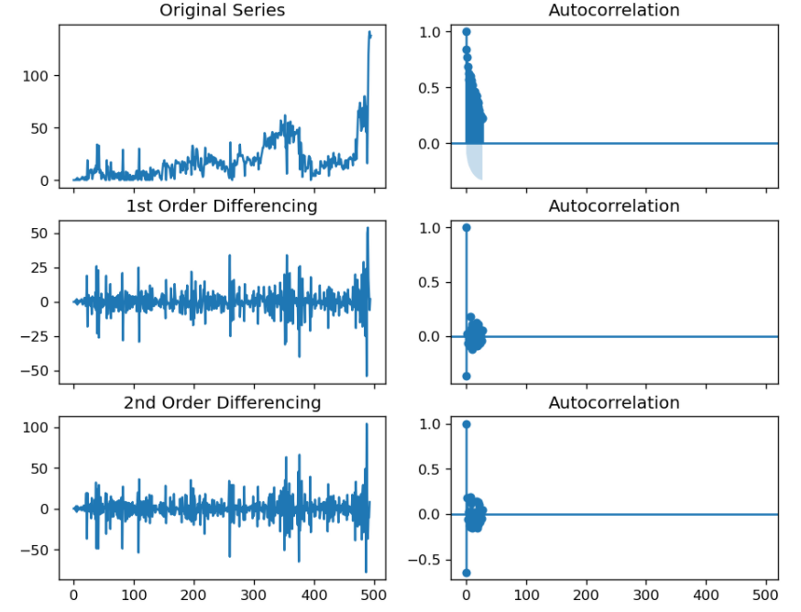
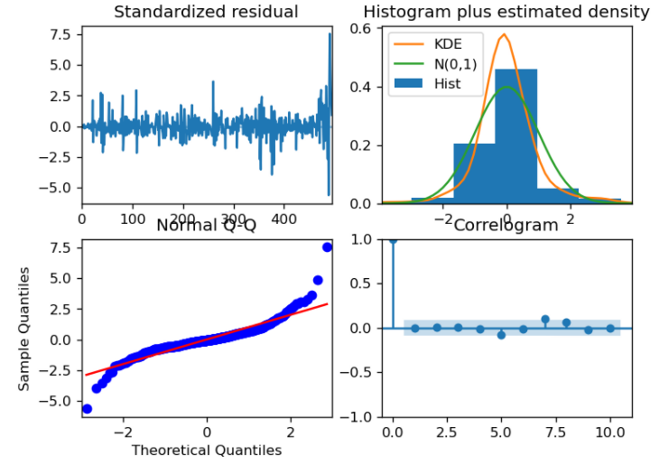
ARIMA Vaccination
In order to forecast vaccination progress, we do 2nd order differencing first to eliminate auto correlation.
We also check the standardized residual, normal Q-Q, density, and correlogram to make sure the model satisfy ARIMA assumptions.

Slide 16
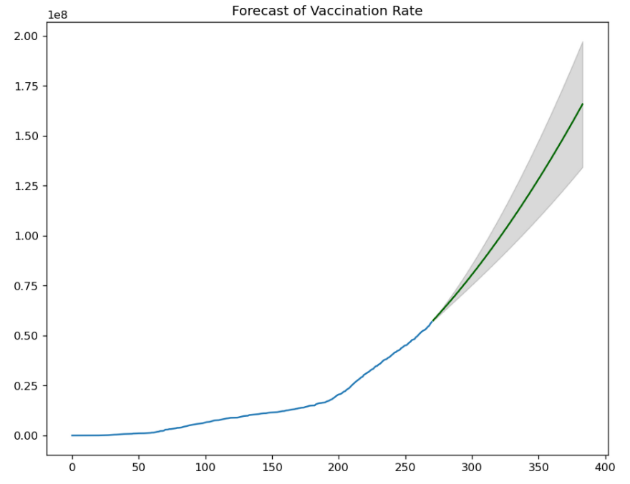
ARIMA Vaccination
People fully vaccinated in Indonesia will reach 50% in January 2022 forecasted with Auto Regressive Integrated Moving Average (ARIMA).
With 50% people fully vaccinated, Indonesia will reach herd immunity easier and it is relatively safer to open strict COVID-19 measures like PPKM

Slide 17
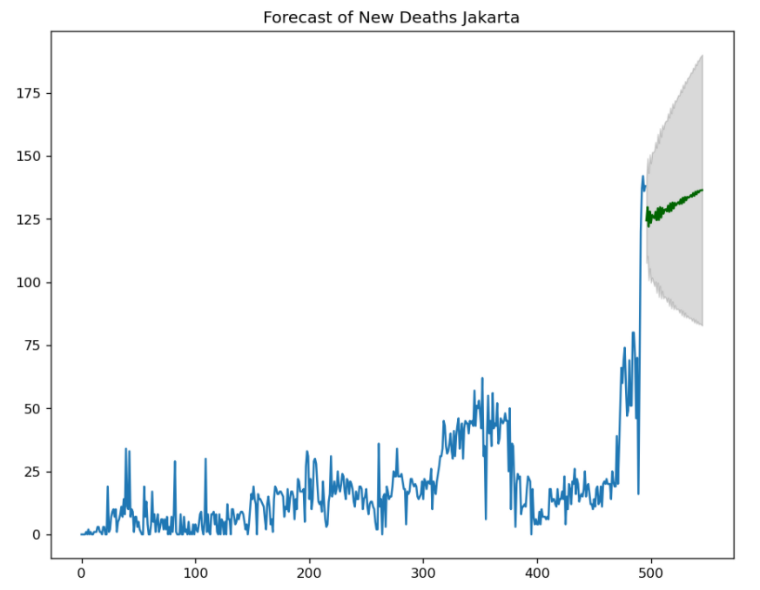
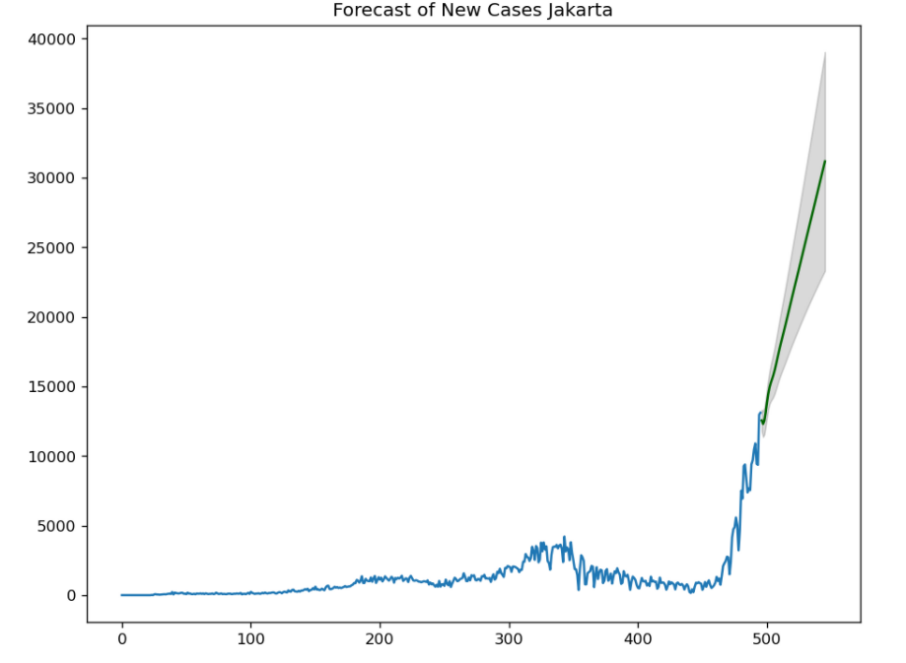
ARIMA New Cases and Deaths
Unfortunately, ARIMA poorly forecast new cases and new deaths. We can see from the results here that ARIMA returns questionable predictions on the daily new cases and deaths.

Slide 18
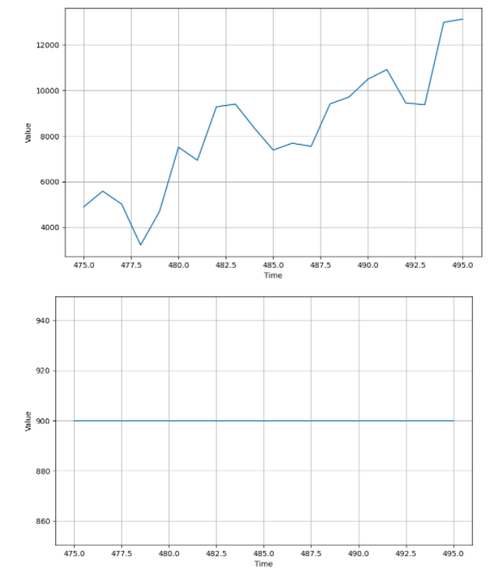
LSTM
Unfortunately, LSTM model does not work properly even after hyperparameter tuning. We think it is because vaccination progress, nes cases, and new deaths data does not have any pattern (seasonality, trend, etc.) to be picked on by the deep learning algorithm.
Two graphs we showed here is how LSTM predict vaccination progress (below) versus what is the actual data (above).

Slide 19
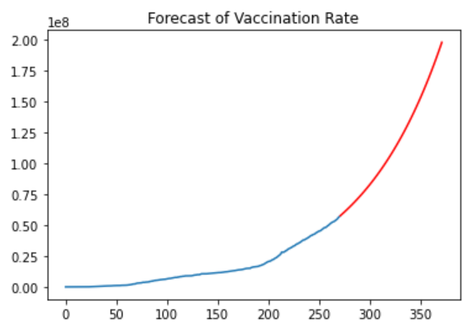
Auto Regressive on Vaccination Rate
Based on Auto Regressive Model, there will be more than 100,000,000 people fully vaccinated by the end of November 2021 and will reach more than 50% population by the beginning of January 2022.

Slide 20
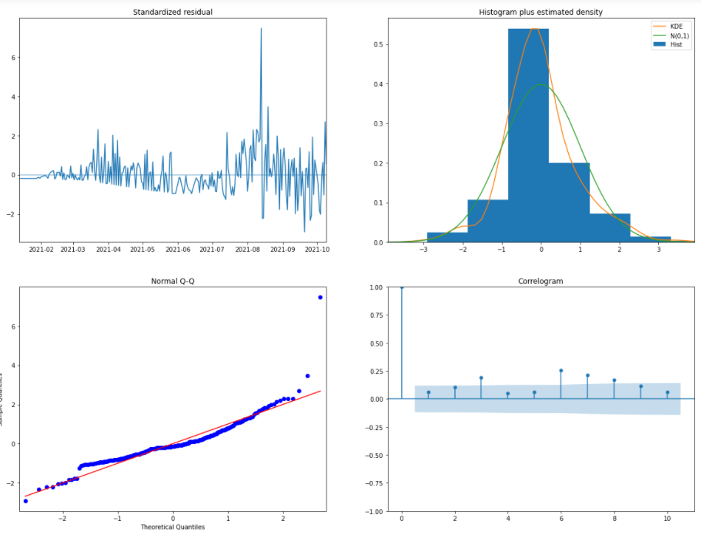
Auto Regressive on Vaccination Rate

Slide 21
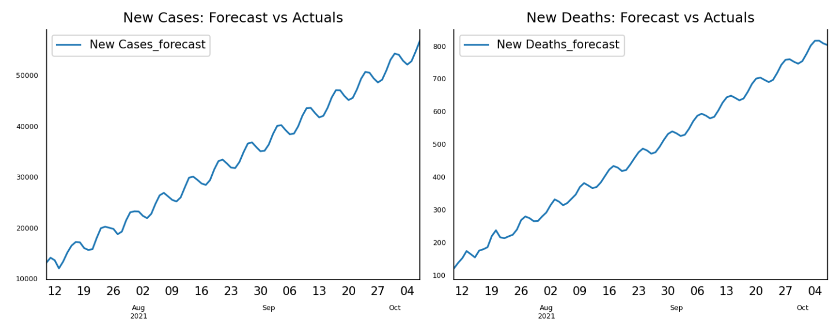
Vector Auto Regressive on New Cases and Deaths
Vector Auto Regression Method is used to predict New Cases and New Deaths simultaneously. This model is designed to forecast two or more correlated data. Unfortunately, the result shows increasing trend of new cases and new deaths forever. This result is clearly unreliable since vaccination and other preventive actions taken by the government have been proven to succesfully bring down new cases and deaths.

Slide 22
Simple Moving Average on Vaccination Rate
Simple Moving Average encounters a problem in forecasting. Instead of showing a trend of increasing rate as time goes on, vaccination rate is predicted to be constant after October 2021. This problem usually arises when the model is used to forecast a long period of time.

Slide 23
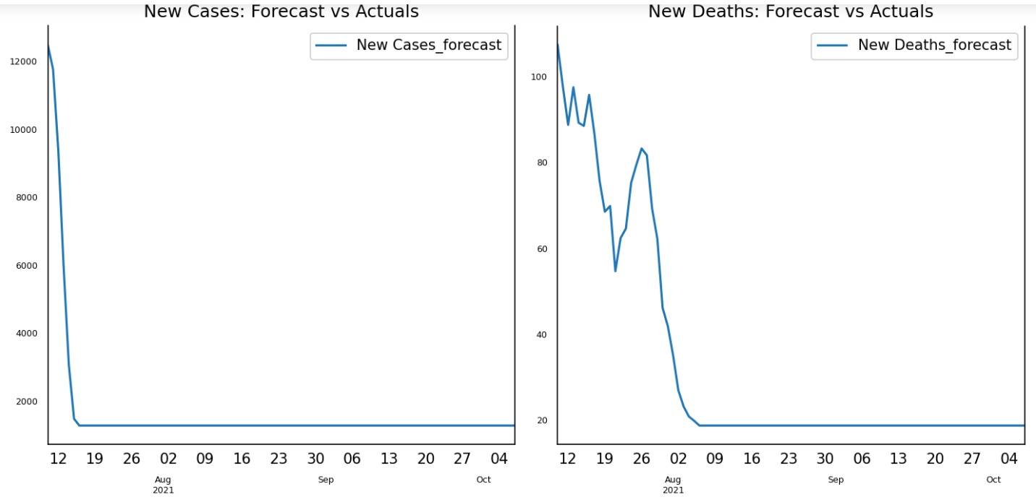
Simple Moving Average on New Cases and Deaths
Similar with Moving Average model in forecasting vaccination rate, the same model fails to forecast new cases and deaths for a long period of time. Thus, it makes the result unreliable.

Slide 24
Conclusion
The most reliable predictions between our four statistical model is ARIMA which predicted vaccination rate in Indonesia will reach 50% in January 2022; making it safer to finally remove COVID-19 measures
Since COVID-19 new case is dependent on so many uncertain variables, we can never say for sure when we can reach a point to normalize daily life. We can, however, expect at least with four statistical models we made that Jakarta, Indonesia, will go back to normal around January 2022 in the most optimist way

Slide 25
Advice
Businesses in Jakarta and its surroundings should prepare their cash to meet daily operations until the first quarter of 2022 to survive at worst case scenario.
Businesses in Jakarta and its surroundings should try to pivot their marketing and sales strategy from offline to online as soon as possible
Digital marketing and sales channels that are possible to be optimized until (time) are social media (Instagram, Facebook, etc.), e-commerce (Tokopedia, Bukalapak, Shopee, etc.), delivery partners (Gojek, Grab, Traveloka, Shopee, etc.)

